Slide 1
Enterprise DevSecOps Implementation Model
Real implementation has 3 repositories minimum:

Slide 2
Shared Responsibility
DevSecOps is a cultural and operational approach that integrates security into every phase of the software development lifecycle (SDLC), transforming security from a final "gate" into a shared responsibility. It builds upon DevOps by ensuring that development, security, and operations teams collaborate continuously to build secure, high-quality software at speed.

Slide 3
Core Principles of the Shared Responsibility Model
Instead of relying on a separate security team to fix issues at the end of development, DevSecOps distributes security ownership across the entire team:
Shift Left: Security is moved to the earliest stages of development (planning and coding) to identify vulnerabilities early, which makes them easier and cheaper to fix.
Security as Code (SaC): Security policies, standards, and controls are automated and version-controlled, allowing them to be tested and deployed alongside application code.
Collaboration: Breaking down silos between Developers, Security specialists, and Operations (Dev-Sec-Ops) ensures security is not an afterthought.
Automated Guardrails: Security tools are embedded directly into the CI/CD pipeline, automatically scanning for vulnerabilities without slowing down the deployment process.

Slide 4
Responsibilities by Team
In a DevSecOps environment, responsibilities are clearly defined:
Developers: Responsible for writing secure code, performing static analysis (SAST) in their IDEs, and fixing vulnerabilities in their code.
Security Team: Moves from being a "gatekeeper" to an enabler, responsible for defining security policies, setting guardrails, and providing tools for developers.
Operations Team: Ensures secure configurations, manages infrastructure as code (IaC), and handles monitoring/patching in production.
Security Champions: Developers within teams who act as security liaisons to advocate for secure practice

Slide 5
Why the Shared Responsibility Model Matters
Reduced Risk: Proactive detection reduces the likelihood of deploying vulnerable applications.
Faster Time-to-Market: Automated testing eliminates the bottlenecks traditional security reviews create.
Cost Savings: Identifying issues early is significantly cheaper than fixing breaches post-production.
Compliance: Automated compliance checks ensure regulatory standards (e.g., GDPR, HIPAA, PCI DSS) are met continuously

Slide 6
DevSecOps and Cloud Security
DevSecOps is critical in cloud environments, where it complements the Cloud Service Provider (CSP) Shared Responsibility Model. While providers (like AWS, Azure, GCP) secure the physical infrastructure ("security of the cloud"), DevSecOps ensures that customers properly secure their data, applications, and configurations ("security in the cloud")

Slide 7
Common Challenges
Cultural Resistance: Shifting from a siloed approach to a collaborative one requires overcoming "us vs. them" mentalities.
Tool Overload: Integrating too many tools can create noise and overwhelm teams with false positives.
Skill Gaps: Finding personnel with expertise in both development and security can be difficult

Slide 8
devsecops-platform (central templates)
application-repos (business apps)
platform-config (policies & governance)

Slide 9
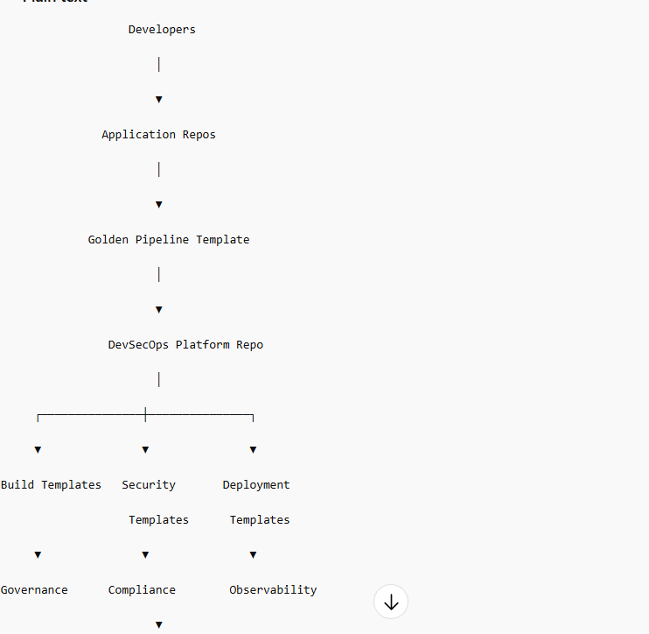
Architecture:
azure

Slide 10
Step 1 — Central DevSecOps Platform Repo
devsecops-platform
Structure:
devsecops-platform/
golden-pipeline/
build/
security/
deployment/
governance/
scripts/
policies/
docs/

Slide 11
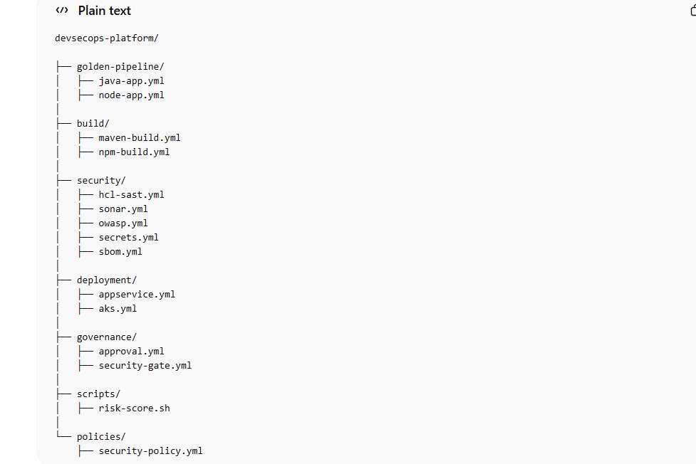
Step 2 — Real Enterprise Folder Structure Example:

Slide 12
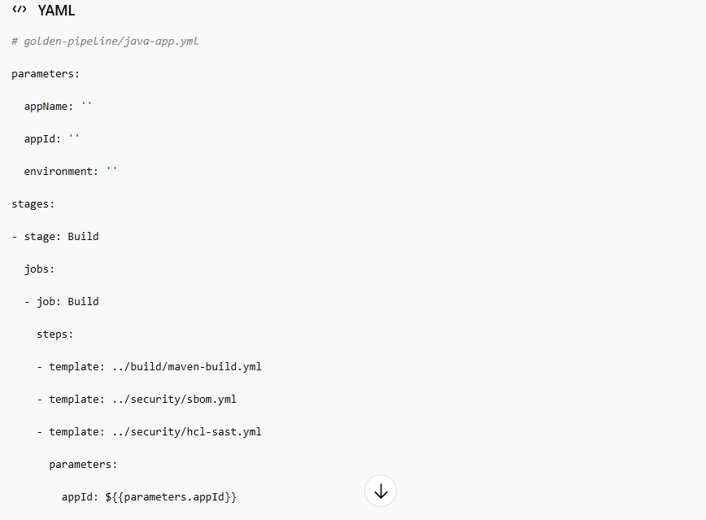
Step 3 — Golden Pipeline (Core of enterprise) Golden pipeline example:

Slide 13
################################# - stage: Deploy jobs: - deployment: Deploy environment: ${{parameters.environment}} strategy: runOnce: deploy: steps: - template: ../deployment/appservice.yml parameters: appName: ${{parameters.appName}}
This is reused by all Java apps.

Slide 14
Step 4 — Application Repo Structure Example:
customer-service/
src/
pom.xml
azure-pipelines.yml

Slide 15
Application pipeline becomes:
trigger:
- master
resources:
repositories:
- repository: devsecops
type: git
name: devsecops-platform
extends:
template: golden-pipeline/java-app.yml@devsecops
parameters:
appName: customer-dev-app
appId: ca72e53b-5bd3-4626-ba24-8d4106cf31c2
environment: DEV

Slide 16
Step 5 — Governance Repo (Real Enterprise Pattern)
Create:
platform-governance
Contains:
approval matrix security policies risk thresholds compliance rules
Example:
security-policy.yml
coverage: 80 criticalVulnerabilities: 0 maxCVSS: 7
Used by security templates.

Slide 17
Step 6 — Enterprise Security Gate Implementation Security template reads policy:
Example:
parameters: coverageThreshold: 80
Then enforce:
condition: succeeded()
Fail if violated.

Slide 18
Step 7 — Enterprise Deployment Model
Deployment template:
parameters:
appName: ''
steps:
- task: AzureWebApp@1
inputs:
azureSubscription: azure-service-connection
appName: ${{parameters.appName}}
package: '$(Pipeline.Workspace)/drop/*.jar'

Slide 19
Step 8 — Enterprise Environment Model Azure DevOps: Environments:
Environments:
DEV UAT PROD
Rules:
DEV:
Auto deploy
UAT:
QA approval
PROD:
Security + Architect approval

Slide 20
Step 9 — Real Enterprise Operating Model Team responsibilities:
Platform Team:
Templates Security tools Governance Deployment patterns

Slide 21
Security Team:
Policies Risk thresholds Compliance rules

Slide 22
Application Team:
Business code only

Slide 23
Step 10 — Multi Application Usage Example Example:
Payment Service
Customer Service
Order Service
Inventory Service

Slide 24
All use:
golden-pipeline/java-app.yml
Only parameters change:
appName: payment-app appId: xxxx environment: DEV

Slide 25
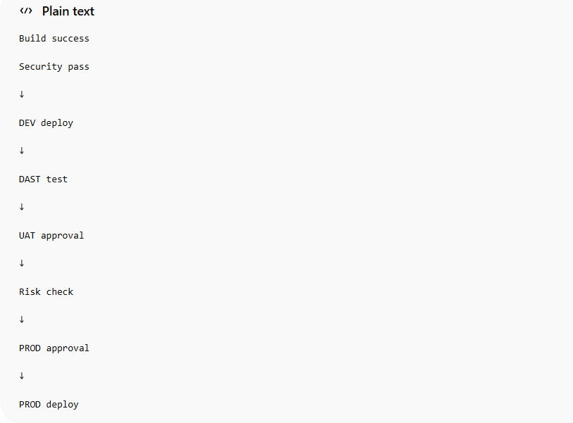
Step 11 — Enterprise Release Governance Real approval flow:

Slide 26
Step 12 — Enterprise Risk Based Deployment Advanced organizations calculate risk score: Example:
Coverage 90% → Risk 1
Coverage 60% → Risk 5
Critical vulnerability → Risk 10

Slide 27
Pipeline logic:
Risk <5 → Deploy
Risk 5–7 → Approval
Risk >7 → Block

Slide 28
Step 13 — Enterprise Observability Integration After deploy: Run:
Health check
Smoke test
Monitoring validation

Slide 29
Example:
script: curl app-url/health
If fails:
Rollback.

Slide 30
Step 14 — Enterprise Platform Evolution Roadmap Typical maturity journey:
Year 1:
CI/CD pipelines
Year 2:
Security integration
Year 3:
Shared templates
Year 4:
Golden pipelines
Year 5:
Internal Developer Platform

Slide 31
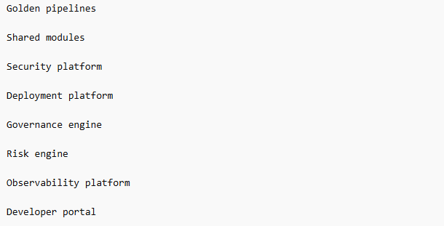
Step 15 — Real Enterprise DevSecOps Platform Components Final platform contains:

Slide 32
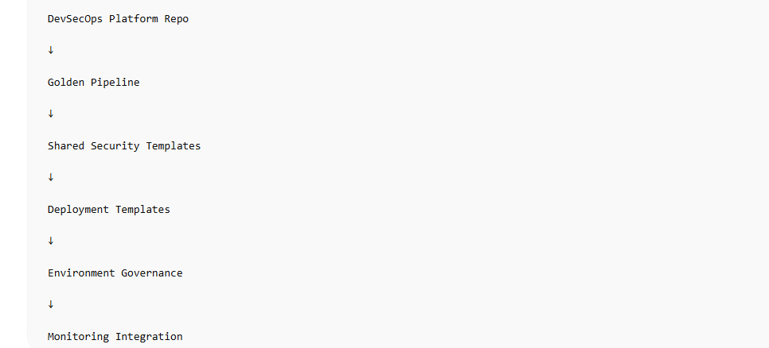
Step 16 — Real Company Implementation Pattern Typical enterprise:

Slide 33
This will support 50 to 60 apps

